Slide 1
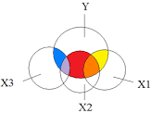
Unraveling Multicollinearity between Predictors with PCLR and PLSLR Techniques
Bindubritta Acharjee

Slide 2

The usual dimension reduction techniques avoid multicollinearity
They undermine the statistical significance of independent variables
Need to follow Principal Component Regression (PCR) and Partial Least Squares Regression (PLSR) to solve this kind of situation
Better prediction model with fewer components for regression analysis

Slide 3
Tumor Dataset for Analysis
Dimension
3,571 Genes X 72 Samples
308 variables (8.6% of total)
Collinearity
Response
Tumor: 25 Normal: 47
SD varies from 0.2 to 1.85
Variance
HDG-select: A novel GUI based application for gene selection and classification in high dimensional datasets Shilan S. Hameed, Rohayanti Hassan, Wan Haslina Hassan, Fahmi F. Muhammadsharif, Liza Abdul Latiff PLoS One. 2021; 16(1): e0246039. Published online 2021 Jan 28. doi: 10.1371/journal.pone.0246039.

Slide 4


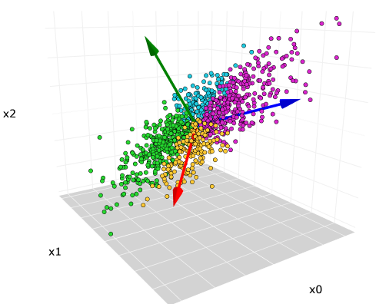
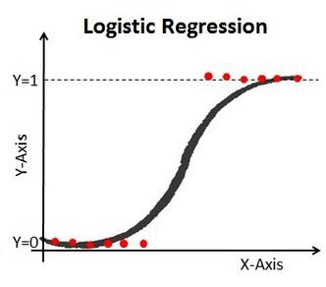
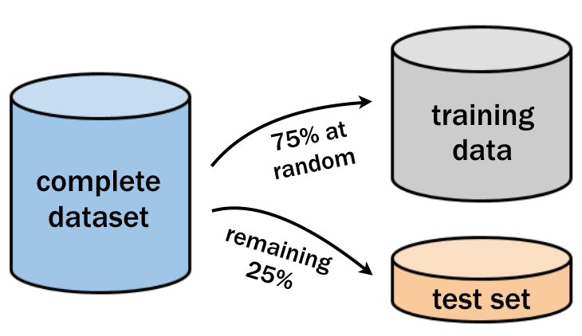
PCLR Method
FEATURE
MATRIX
X-SCALAR
PARTIAL LEAST-SQUARE ANALYSIS
DUMMY 0/1
PREDICTIONS
PRINCIPAL COMPONENT ANALYSIS
RESPONSE VECTOR
X-PCA
DUMMY VECTOR

Slide 5
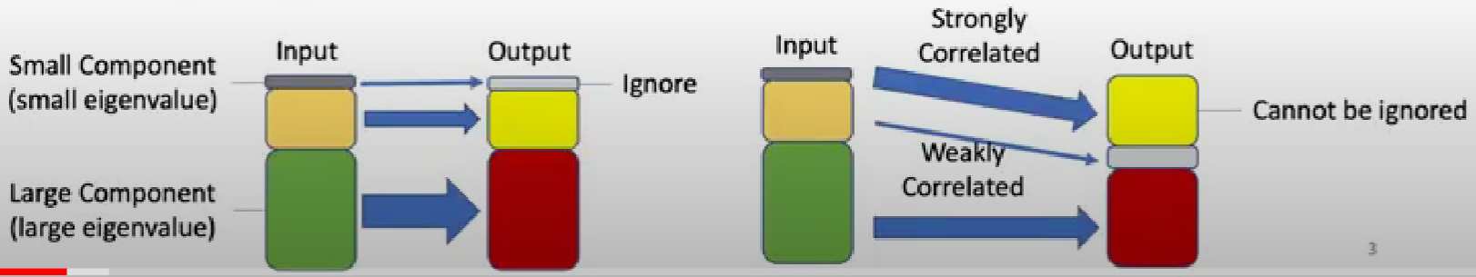
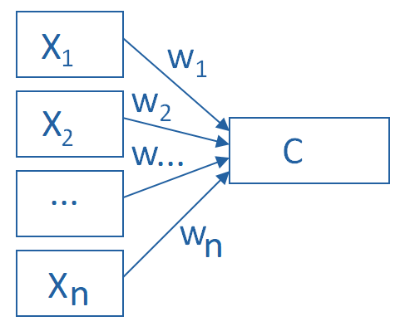
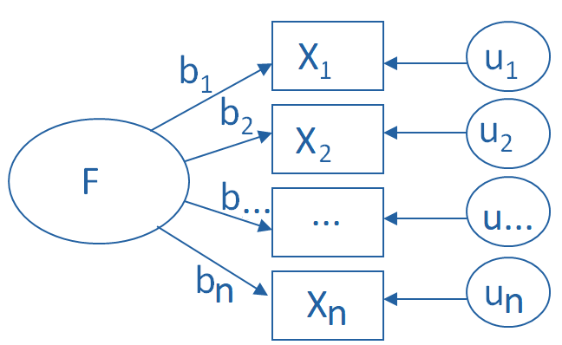





PCLR vs PLSLR ⇨ PCA vs PLS
$$y_{n X 1}=X_{n X \left(p+1\right)}{ . β}_{\left(p+1\right) X 1}+ε_{n X 1}$$
PRINCIPAL COMPONENT ANALYSIS
$$X_{1}=\left(b_{1}×F\right)+u_{1}$$
$$X_{2}=\left(b_{2}×F\right)+u_{2}$$
$$⋮$$
$$X_{n}=\left(b_{n}×F\right)+u_{n}$$
$$C=w_{1}X_{1}+w_{2}X_{2}+⋯+w_{n}X_{n}$$
PARTIAL LEAST-SQUARE ANALYSIS

Slide 6
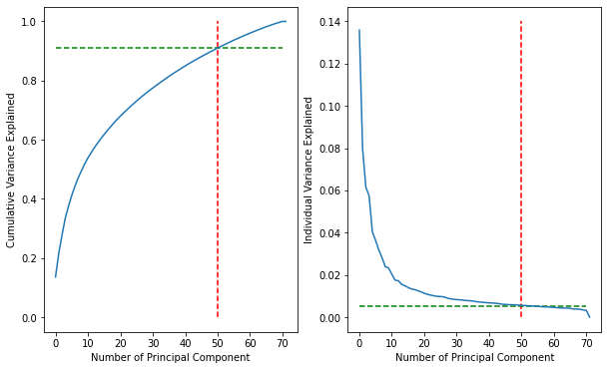
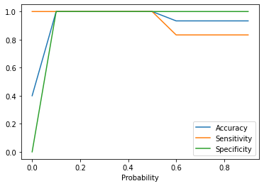
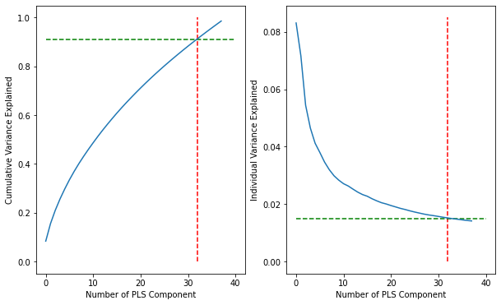
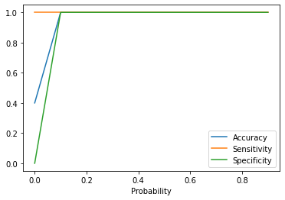
Analysis and Results
Fig. 1
Scree Plot for PCA
Fig. 2
KPIs vs cut-off points for PCLR Model
Fig. 3
Scree Plot for PLS
Fig. 4
KPIs vs cut-off points for PLSLR Model

Slide 7
Findings and Future Scopes
Criterial | PCLR | PLSLR
Total components for 91% explained variance | 50 | 32
1st component explains | 13.58% | 8.31%
2nd component explains | 7.96% | 7.17%
3rd component explains | 6.15% | 5.45%
Cut-off bandwidth for 100% accuracy | 0.1-0.5 | 0.1-0.9
Based on the results from the analysis, we can conclude that PLSLR performs better over PCLR.
01
02
Overfit Model
PLS-DA
FUTURE SCOPES:
To further analyse the model for overfitting
Partial least squares discriminant analysis

Slide 8


